Slide 1
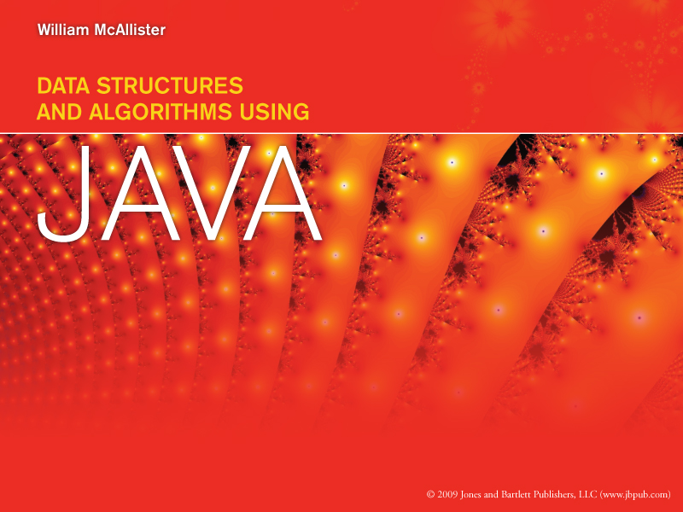
Restricted Structures
Chapter 3
Click to proceed

Slide 2

How To View This Presentation
This presentation is arranged in outline format. To view the slides in proper order
For each slide
  Read the entire slide’s text
  Then click the links (if any) in the text, in the order they appear in the text
  Then click the or button at the bottom-right side of the slide
  Do not use the space bar to advance

Slide 3
Overview Of Restricted Structures
All restricted structures severely restrict the basic operations and access modes
The two most commonly used restricted structures are Stack and Queue
  Both can be implemented as array-based structures
  Their restrictions are consistent with some applications, and the performance of Stack and Queue is excellent
Coding generic data structures can be methodized. Our Stack implementation will be used as a case study
A priority queue is a restricted structure used in scheduling applications
Java’s API Stack class is a generic stack structure

Slide 4
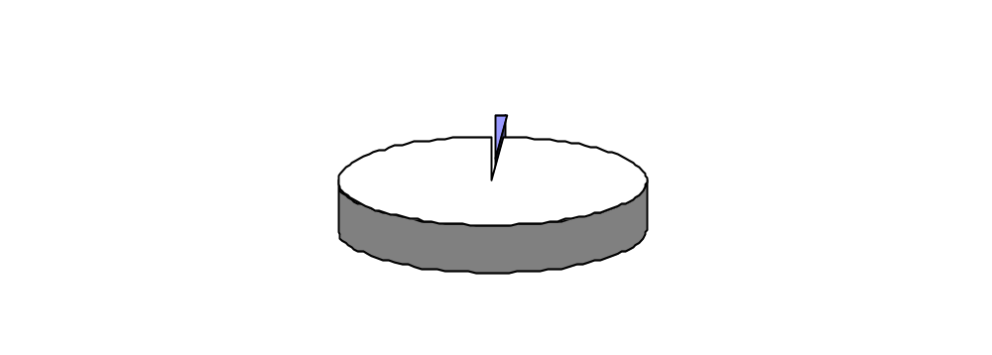
Restrictions on Restricted Structures
Operation restrictions
  Update is not supported
  Insert is supported (not restricted)
  Fetch and Delete are combined into one operation
Access mode restrictions
  Key field mode is not supported
  Node number mode is severely restricted
Still, they are ideally suited for some applications

Slide 5
Insert Operation
A Restricted Structure after Nodes A, then B, the C and Finally D Have Been Inserted
node D
node C
node B
node A

Slide 6
Restrictions on Node Number Access Mode
Can’t say “Fetch-and-Delete the 3rd node”
Can only say “Fetch-and-Delete”
  For a Queue: the node returned and deleted is the node in the structure the longest time
  For a Stack: the node returned and deleted is the node in the structure the shortest time

Slide 7
Combined Fetch-and-Delete Operation
(assumes Node A was inserted first, Node D last)
A Queue and a Stack before and after a Fetch-and-Delete Operation is performed
node D
node D
node D
node C
node C
node C
node C
node B
node B
node B
node B
node A
node A
node A
before
after
before
after
Queue
Stack

Slide 8
Stack
Stack has its own terminology
When based on an array, its operation algorithms are simple and fast
It is implemented as a separate class to promote software reusability and generic conversion
Used in many applications
Its two operations are sometime expanded and it can be made dynamic

Slide 9
Terminology of Stacks
Top of Stack
4th Push
3rd
Operations
  The Insert operation is called Push
    We say an item is pushed “onto” a stack
  The Fetch-and-Delete operation is called Pop
    We say an item is popped “off of”, or “from”, a stack
Errors
  A Pop from an empty stack is an underflow error
  A push onto a full stack is an overflow error
The last item pushed onto the stack is said to be at the “top” of the stack
Stack is a Last-In-First-Out structure, LIFO
2nd
1st

Slide 10
Stack Operations on a Three Member Stack
Operation
Result
The Stack After the Operation
push(nodeA)
nodeA is stored
nodeA
pop()
nodeA is returned
empty
pop()
**Underflow Error**
empty
push(nodeB)
nodeB is stored
nodeB
push(nodeC)
nodeC is stored
nodeC
nodeB
push(nodeD)
nodeD is stored
nodeD
nodeC
nodeB
push(nodeE)
**Overflow Error**
nodeD
nodeC
nodeB
Continued

Slide 11
Stack Operations on a Three Member Stack
(continued)
Initial Stack
nodeD
nodeC
nodeB
Operation
Result
The Stack After the Operation
pop()
nodeD is returned
nodeC
nodeB
pop()
nodeC is returned
nodeB
pop()
nodeB is returned
empty
pop()
**UnderFlow Error**
empty

Slide 12
Stack Operation Algorithms
For An Array Based Stack
Initialization, Push, and Pop algorithms assume
  An array, data, stores references to the nodes
  An integer variable top stores the index of the last node pushed
  An integer variable size stores the size of the array
size
top
data[3]
null
data[2]
null
data[1]
null
data[0]
null

Slide 13
Stack Initialization Algorithm
For a Stack of Size S
top = -1;
size = s;
size
0 4
top
0 -1
data[3]
null
data[2]
null
data[1]
null
data[0]
null

Slide 14
Push Algorithm
(assumes newNode is being pushed)
if(top == size - 1)
return false; // ** overflow error **
else
{ top = top + 1;
data[top] = newNode.deepCopy();
return true; // push operation successful
}

Slide 15
Memory Action of the Push Algorithm
size
4
size
4
top
-1
top
-1 0 1 2
100
data[3]
null
data[3]
null
Carol
Avenue C
234 8989
data[2]
null
data[2]
100
44
data[1]
null
data[1]
44
Vick
Avenue V
936 7281
data[0]
null
data[0]
300
300
Mike
Avenue M
546 7373
Initialized State
After Mike, then Vick, then Carol have been Pushed
size
4
600
top
-1 0 1 2 3
Bill
Avenue B
978 5634
100
data[3]
600
Carol
Avenue C
234 8989
data[2]
100
44
data[1]
44
Vick
Avenue V
936 7281
data[0]
300
300
Mike
Avenue M
546 7373
Full State: (the next Push generates an overflow error)

Slide 16
Pop Algorithm
if(top == -1)
return null; // ** underflow error **
else
{ topLocation = top;
top = top - 1;
return data[topLocation]; // returns a
} // shallow copy

Slide 17
Memory Action of the Pop Algorithm
size
4
top
-1 0 1
Client Application
data[3]
null
44
data[2]
null
Vick
Avenue V
936 7281
data[1]
44
300
data[0]
300
Mike
Avenue M
546 7373
The Initial Stack (Mike then Vick has been Pushed)
size
4
top
-1 0 1 0
Client Application
data[3]
null
44
data[2]
null
Vick
Avenue V
936 7281
data[1]
44
300
data[0]
300
Mike
Avenue M
546 7373
The Stack After Vick has been Popped

Slide 18
Stack Implementation
Implemented as a class
Private data members
  data, next, and size
Methods
  A constructor to initializes data and next and allocates the array
  push and pop
    the Java equivalent of the pseudocode algorithms
  showAll to output all nodes
    invokes the node definition class’ toString method
The method pop returns a shallow copy

Slide 19
Stack Applications
Any algorithm that requires a LIFO structure
  Artificial intelligence algorithms e.g., backtracking
  Tree traversals
  Graph traversals
  In compilers
    For passing information to, and from, subprograms
    Remembering return addresses
    Evaluation of arithmetic expressions

Slide 20
Evaluation of Arithmetic Strings
Programmers write in infixed notation
  operators in between operands: 2 + 3 * 4
  Ambiguity of operand order requires precedence rules (slow runtime evaluation)
To improve speed, compilers
  change infixed notation to postfixed 2 3 4 * + using a Stack and a Queue structure
  Use a Stack to evaluate the expression at run time

Slide 21
Evaluating Postfixed Expressions
1- Begin at left side of the postfixed expression
2- Move to right
3- if an operand is found
  Push it onto a stack
  else when an operator is found
  Pop two operands off the stack
  Apply the operator to these two operands
  Push the result onto the stack
4- Repeat steps 2 and 3 until the end of the expression is reached. Then pop the value of the expression off the stack
Flowchart

Slide 22
Postfixed Expression Evaluation Algorithm
Initialize stack s to empty.
Fetch the first token, t, from the postfixed expression
is t empty?
Yes
result = s.pop( )
No
is t an operator?
end
No
s.push( t )
Yes
o1 = s.pop( )
o2 = s.pop( )
apply operator t to o1 and o2
(v = o1 t o2)
s.push( v )
get the next token, t
Stack Progression

Slide 23
Stack Progression During The Evaluation Of
2 3 4 * +
Progression → → →
4
3
3
3
12
2
2
2
2
2
2
2
14

Slide 24
Expanded Stack Operations
Reinitialize the stack to empty, init
  top = -1;
Test for an empty stack (underflow condition), isEmpty
  if (top == -1) // stack empty
Test for a full stack (overflow condition), isFull
  if (top == size - 1) // stack full
Continued

Slide 25
Expanded Stack Operations
(continued)
Pop a node from the stack without deleting it from the structure, peek
  Same as Pop algorithm, but top is not decremented
Expand the stack at run time within the limits of system memory (inside of the Push algorithm)
  Use Java’s arraycopy and set size to the expanded size

Slide 26
Performance of the Stack Structure
Speed
  Push performs 4 memory access to: fetch top and size, rewrite top, and write the node location into data[top], O(1)
  Pop performs 3 memory accesses to: fetch top, rewrite top, and to fetch the contents of data[topLocation], O(1)
Density > 0.8 for node widths >= 16 bytes
Outperforms the Unsorted-Optimized structure

Slide 27
Density of a Stack
Density = information bytes / total bytes
  Information bytes = n * w
    n is the number of nodes, w is the bytes per node
  Overhead = 4n + 8
    4 bytes per array element + 8 bytes for next and size
Density = n * w / (n * w + 4n + 8)
  As n gets large n * w/ (n * w + 4n + 8) → 1/(1 + 4/w)

Slide 28
Variation in the Density of a Stack With Node Width
Density of the Structure Stack
for n >= 100
1
0.8
0.6
Density (Ds)
0.4
0.2
0
0
20
40
60
80
100
Bytes Per Node (W)

Slide 29
Comparison of the Stack and Unsorted-Optimized Structures
Data Structure | Operation Speed (in memory accesses) |  |  |  |  |  |  | Condition for Density >0.8
 | Insert | Delete | Fetch | Update = Delete + Insert | Average[1] | Big-O Average | Average for n = 10⁷
Unsorted -Optimized array | 3 | ≤ n | ≤ n | ≤ n +3 | (3n+6)/4 | O(n) | 0.75x107 + 1.5 | wi > 16
Stack | 4 push | combined with Fetch | 3 (pop) | not supported | 7/2 = 3.5 | O(1) | 3.5 | w_{i} > 16
[1] Assumes all operations are equally probable and is therefore calculated as an arithmetic average of the four operation times.

Slide 30
Queue
Like Stack,
  Queue has its own terminology
  When based on an array, its operation algorithms are simplistic and demonstrate good performance
  It is implemented as a separate class to promote software reusability and generic conversion
  It is used in many applications
  Its two operations are sometime expanded, and it can be made dynamic

Slide 31
Terminology of Queues
Enqueue at Reat
Operations
  The Insert operation is called Enqueue
    We say an item is “entered into” a queue
  The Fetch-and-Delete operation is called Dequeue
    We say an item is “removed from”, a queue
Errors
  A Dequeue from an empty queue is an underflow error
  An enqueue into a full queue is an overflow error
The first and last items entered into a queue is said to be at the “front” and “rear” of the queue
Queue is a First-In-First-Out structure, FIFO
Dequeue from Front

Slide 32
Queue Operations
Node A
Node B
Node C
Node D
the original queue
front
rear
Node A
Node B
Node C
Node D
Node E
the queue after Node E is inserted
(Enqueue)
front
rear
Node B
Node C
Node D
Node E
after Node A is Fetched-Deleted (Dequeue)
front
rear

Slide 33
Queue Operation Algorithms
For An Array Based Stack
Initialization, Enqueue, and Dequeue algorithms assume
  An array, data, stores references to the nodes
  An integer variable size stores the size of the array
  Integer variables front and rear keep track of the front and rear of the queue
  An integer variable numOfNodes
  stores the number of nodes
  in the queue
size
numOfNodes
front
rear
data[3]
null
data[2]
null
data[1]
null
data[0]
null

Slide 34
Queue Initialization Algorithm for a Queue of Size s
size = s; numberOfNodes = 0;
front = 0; rear = 0;
size
4
numOfNodes
0
front
0
rear
0
data[3]
null
data[2]
null
data[1]
null
data[0]
null

Slide 35
Enqueue Algorithm
(assumes newNode is being inserted)
if(numOfNodes == size)
return false; // ** overflow error **
else
{ numOfNodes = numOfNodes + 1;
data[rear] = newNode.deepCopy();
rear = (rear + 1) % size; // % keeps rear in bounds
return true; // Enqueue operation successful
}

Slide 36
Memory Action OF The Enqueue Algorithm
size
4
size
4
numOfNodes
0
numOfNodes
0 1 2 3
front
0
front
0
rear
0
rear
0 1 2 3
100
Carol
Avenue C
234 8989
data[3]
null
data[3]
null
44
data[2]
null
data[2]
100
Vick
Avenue V
936 7281
data[1]
null
data[1]
44
300
data[0]
null
data[0]
300
Mike
Avenue M
546 7373
Initialized State
After Mike, then Vick, then Carol have been Inserted

Slide 37
Dequeue Algorithm
if(numOfNodes == 0)
return null; // ** underflow error **
else
{ frontLocation = front;
front = (front + 1) % size; // % keeps front in
// bounds
numOfNodes = numOfNodes - 1;
return data[frontLocation];
}

Slide 38
Memory Action of the Dequeue Algorithm
size
4
numOfNodes
0 1 2 3 2
front
0 1
rear
0 1 2 3
100
data[3]
null
Carol
Avenue C
234 8989
data[2]
100
44
client application
data[1]
44
Vick
Avenue V
936 7281
data[0]
300
300
Mike
Avenue M
546 7373
the Queue After a Dequeue Operation Returns the Location of Mike’s Node
size
4
numOfNodes
0 1 2 3 2 1
front
0 1 2
rear
0 1 2 3
100
data[3]
null
Carol
Avenue C
234 8989
data[2]
100
44
client application
data[1]
44
Vick
Avenue V
936 7281
data[0]
300
300
Mike
Avenue M
546 7373
the Queue After a Dequeue Operation Returns the Location of Vick’s Node

Slide 39
Performance of a Queue
Speed
  Enque performs 6 memory access to: fetch numOfNodes,size, and rear; rewrite top and numOfNodes, and write the node location into data[rear], O(1)
  Dequeue performs 6 memory accesses to: fetch numOfNodes, front,and size; rewrite front and numOfNodes, and to fetch the contents of data[front], O(1)
Density > 0.8 for node widths >= 16 bytes
Outperforms the Unsorted-Optimized structure

Slide 40
Density Of A Queue
Density = information bytes / total bytes
  Information bytes = n * w
    n is the number of nodes, w is the bytes per node
  Overhead = 4n + 16
    4 bytes per array element + 16 bytes for front, rear, size, and numOfNodes
Density = n * w / (n * w + 4n + 16)
  As n gets large n * w/ (n * w + 4n + 16) → 1/(1 + 4/w)
Density → 1/(1 + 4/w) is the same as that of a Stack

Slide 41
Variation in the Density of a Stack With Node Width
Density of the Structure Stack
for n >= 100
1
0.8
0.6
Density (Ds)
0.4
0.2
0
0
20
40
60
80
100
Bytes Per Node (W)

Slide 42
Comparison of Stack’s Performance
With Previously Developed Structures
Data Structure | Operation Speed (in memory accesses) |  |  |  |  |  |  | Condition For Density >0.8
 | Insert | Delete | Fetch | Update = Delete + Insert | Average[1] | Big-O Average | Average for n = 10⁷
Unsorted -Optimized array | 3 | ≤ n | ≤ n | ≤ n +3 | (3n+6)/4 | O(n) | 0.75x10⁷ + 1.5 | w > 16
Stack | 4 (push) | combined with fetch | 3 (pop) | not supported | 7/2 = 3.5 | O(1) | 3.5 | w > 16
Queue | 6 enqueue | combined with fetch | 6 dequeue | not supported | 12/2 = 6 | 12/2 = 6 | 6 | w > 16
[1] Assumes all operations are equally probable and is therefore calculated as an arithmetic average of the four operation times.
[1] Assumes all operations are equally probable and is therefore calculated as an arithmetic average of the four operation times.

Slide 43
Implementation Of A Queue
Implemented as a class
Private data members
  data, numberOfNodes, front, rear, and size
Methods
  A constructor initialize the data members and allocate the array
  enqueue and dequeue
    the Java equivalent of the pseudocode algorithms
  showAll to output all nodes
    invokes the node definition class’ toString method
The method dequeue returns a shallow copy

Slide 44
Queue Applications
Any algorithm that process data in the order it is received, FIFO
  Print spoolers (several tasks sharing a printer)
  Queuing theory algorithms in Operations Research
  Artificial intelligence algorithms
  Sorting algorithms
  Graph traversals
  Conversion of infixed expressions to postfixed

Slide 45
Methodized Generic Coding Process
Code a node definition class and a non-generic data structure class that complies to a set of coding guidelines (e.g., our Stack and Listing classes)
Test and debug the two classes
Use a four-step methodology to convert the data structure class to a generic implementation

Slide 46
Generic Coding Guidelines
The node definition and the data structure are coded as two separate classes
The data structure cannot mention the names of the data fields that make up a node
If the structure is going to be encapsulated, a method to perform a deep copy of a node must be coded in the node definition class
If the structure is going to be accessed in the key field mode, a method to determine if a given key is equal to the key of a node must be coded in the node definition class
The data structure class cannot mention the key field’s type

Slide 47
Four-Step Methodology To Convert a Data Structure Class To A Generic Structure
Step 1
  Add a generic placeholder at the end of the class’ heading e.g., <T>
  public class GenericStack <T>
Step 2
  Replace all occurrences of the name of the node definition class with the generic placeholder T
  e.g., public boolean push( T newNode)
Step 3
  Wherever the operator new operates on the placeholder T, substitute Object for T, include coercion
  e.g., data = (T[ ]) new Object[100]
Continued

Slide 48
Four-Step Generic Conversion Methodology
(continued)
Step 4
  Wherever a method operates on an instance of type T (e.g., newNode)
    The method’s signature is added to an interface (named, e.g., GenericNode), which must be implemented by the node definition class
    An instance of the interface is declared and assigned the instance’s address
    Generic node = (GenericNode) newNode;
    The method invocation is changed to operate on the instance of the generic type
    e.g., data[top] = node.deepCopy();

Slide 49
Priority Queue
The Insert operation is called Add
  Nodes are assigned a priority when inserted
The Fetch-and-Delete operation is called Poll
  The node with the highest, or lowest, priority is returned (depending on the Priority Queue structure)
  Various strategies are employed in the event of a priority tie
    One strategy is the node in the structure the longest is returned, FIFO
Priority Queues are often implemented using a Heap (discussed in Chapter 8)
Operating systems use Priority Queues in their task scheduling algorithms

Slide 50
Java’s API Stack Class
A generic data structure
  Access is restricted to the node at the top of the stack
  Supports five Operations
  Not encapsulated
  Stores objects, but primitive types are wrapped automatically in Wrapper objects
  Expandable
Client codes
Stack <Car> garage = new Stack<Car> ( )
to create an empty homogeneous stack named garage that can store only Car objects

Slide 51
Five Basic Operations in the Class Stack
Table assumes the heterogeneous structure boston was declared as:
Stack boston = new Stack( );
And the code is executed in the order shown
Basic Operation | Stack method name | Coding example | Comments
Test for empty | empty | if(boston.empty( )) System.out.println(“boston is empty); | Returns true if empty, otherwise false
Push | push | boston.push(tom); // adds tom to boston boston.push(mary); // adds mary to boston boston.push(21); // adds 21 to boston | boston expands dynamically. the 21 gets wrapped
Find a node’s position on the stack | search | if(boston.search(tom) != 1) System.out.println(Tom’s node is not ” + at the top of the stack”); | returns a node’s position on the stack
Pop | pop | int i = (Integer) boston.pop( ) // fetch 21 temp = (Node) boston.pop( ) // fetch mary temp = (Node) boston.pop( ) // fetch tom | Coercion not necessary for homogeneous uses. Next pop throws an exception.
Peek | peek | boston.push(tom); temp = boston.peek( ); // tom fetched | tom is not deleted.

Slide 52


The End
Return to, Overview, Restrictions, Stack, Queue, Methodized Generic Conversion Process, Priority Queue, or Java’s Stack class
End Presentation

